Slide 1
Category review: Chips
June 2020
Retail Analytics
Brand note: If client logo is not required, use alternate title page layout right click slide thumbnail > Layout > Title

Slide 2
Notes:
To view Privacy video explaining how important data privacy is to Quantium, please click here: https://www.youtube.com/watch?v=Zq1QDAkoRzU
or here Q:\Company Reference\Brand & Design\Brand videos\Q Privacy.mp4
At Quantium, we believe that data is the behavioural footprint of humanity and that it has to be treated with the utmost care and responsibility.
Histories, attitudes, indeed lives are stored within it in ways that aren’t always apparent – and that’s what makes its potential so powerful.
To work with it responsibly, sensitively, we set ourselves the highest data privacy protection and governance standards.
We have spent 17 years perfecting privacy-by-design and secure-by-design principles. Central to this is not holding any personally identifiable information about people –
we neither receive it, and put the necessary protections in place to be unable to decipher it.
Every aspect of handling data is safeguarded: from its de-identification, to its encryption – data security is paramount and of the highest grade.
We pride ourselves on gaining the trust of iconic organisations around the world through years of securely working with their data,
and in turn the trust that builds with their stakeholders.

Slide 3
Executive summary
01
Task 1
There are no missing values present in the customers and transaction datasets.
Client total sale is 1933115 from July 2018 to June 2019.
Maximum sales are done in December 2018.
There are total 72636 distinct customers with 263125 distinct transactions.
Customer with card number 230078 is having maximum total sales of 138.6.
Kettle brand is having maximum total sales of 390239.8.
Customers with mainstream account are having maximum total sales of 750744.5 whereas customers with premium account are having minimum sales of 506159.
Customers in life stage of OLDER SINGLES/COUPLES are having maximum total sales of 402426.8.
02
Task 2
After comparison it was found that total sales of different stores are not same.
Store number 226 is having maximum total sales of 17605.45.
Quantity purchased by each store is almost same.
Maximum quantity of 4001 is purchased by store number 226.

Slide 4
01
Category
Chips brand
Life stage of families purchasing chips.
Account type of customers purchasing chips.
Store numbers from which chips are purchased.
Name of the products.

Slide 5
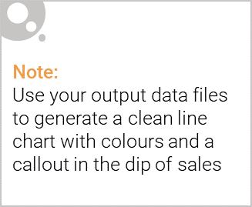
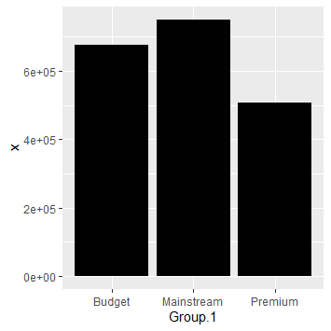
Overview: your key callout for the category should be included here
Maximum total sales are coming from customers belonging mainstream account category whereas for premium account category total sales are minimum.

Slide 6
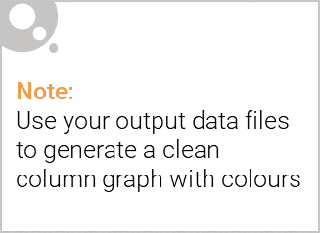
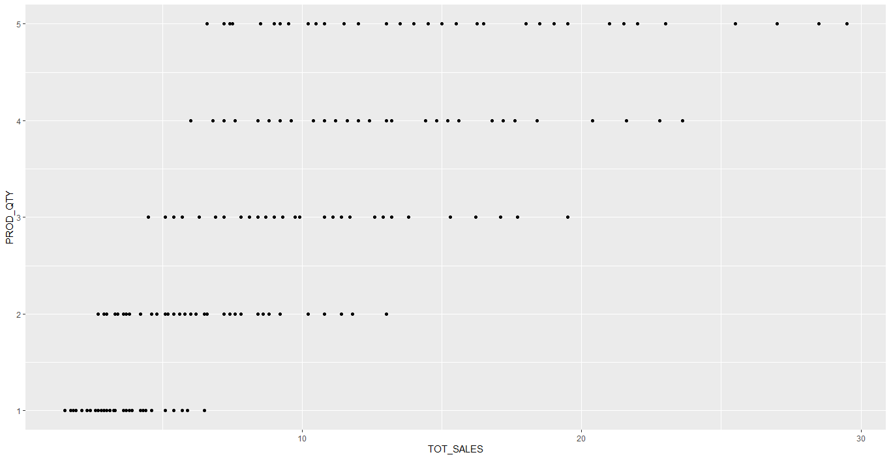
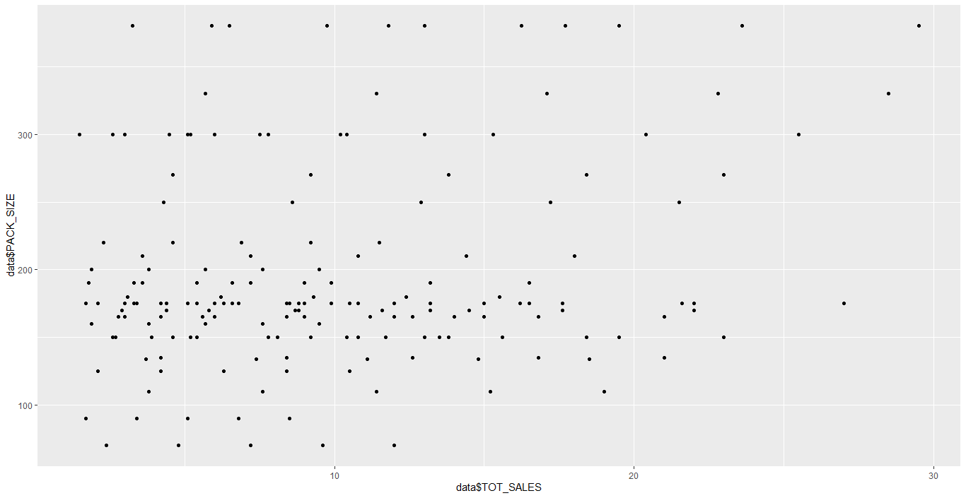
This slide will be commentary on affluence and its effect on consumer buying for the category of chips
It can be observed that product quantity has some influence on total sales. As product quantity increases, total sales of the product also increases.
It can be observed as pack size of products increases total sales also increases.
It is observed that Dorito Corn Chp supreme 380g are showing maximum total sales of 39052 whereas Woolworths Medium Salsa 300g are having minimum total sales of 4050.

Slide 7
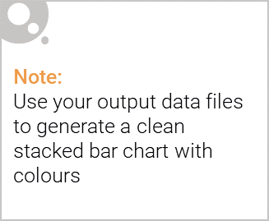
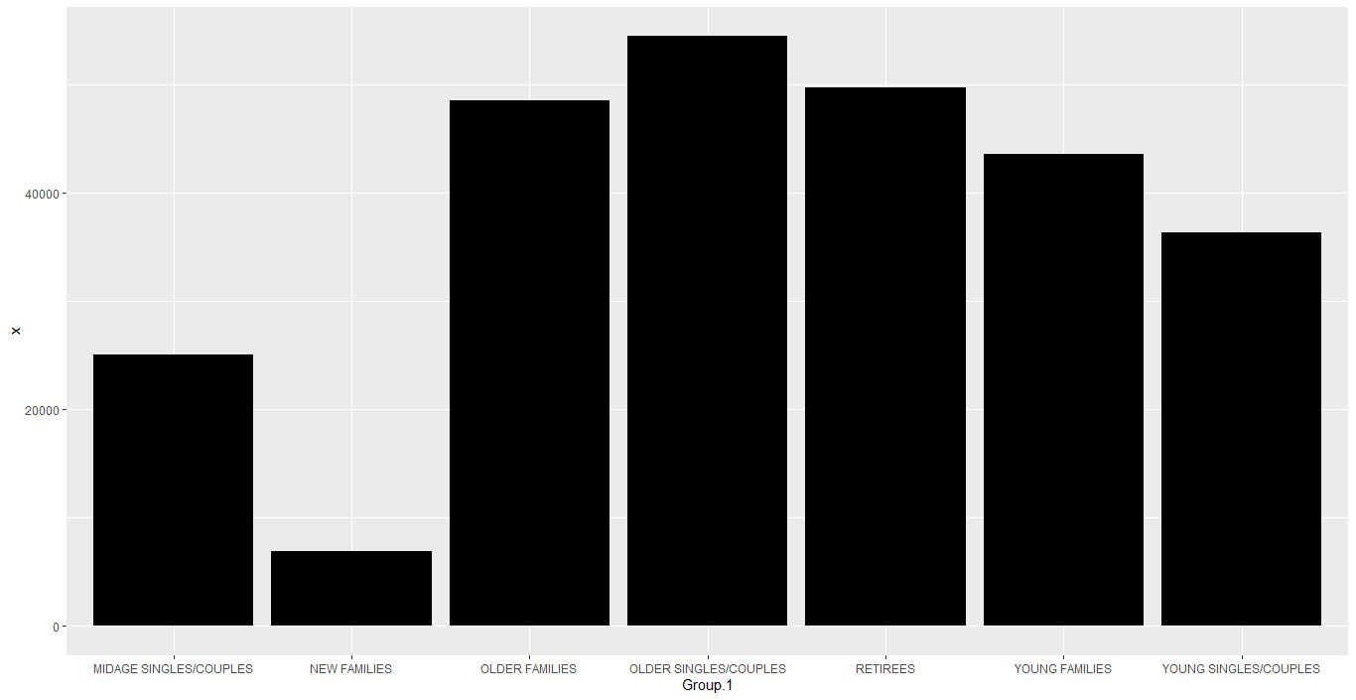
Editable (delete this)
Stretch: Try visualising the proportion of customers by affluence and life stage on this slide
Families belonging to older couples/ singles life stage are showing maximum total sales.
Families belonging to new family life stage are showing minimum toral sales.

Slide 8
02
Trial store performance

Slide 9
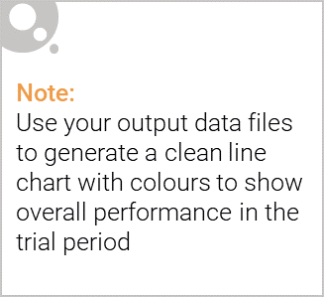
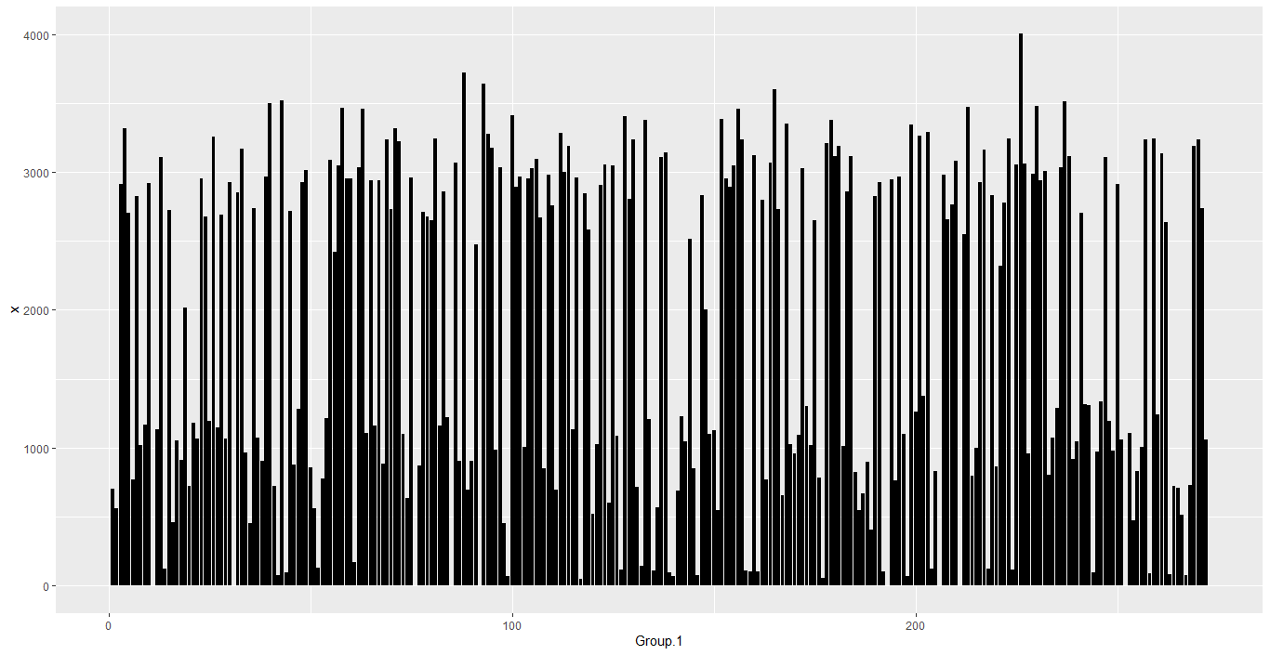
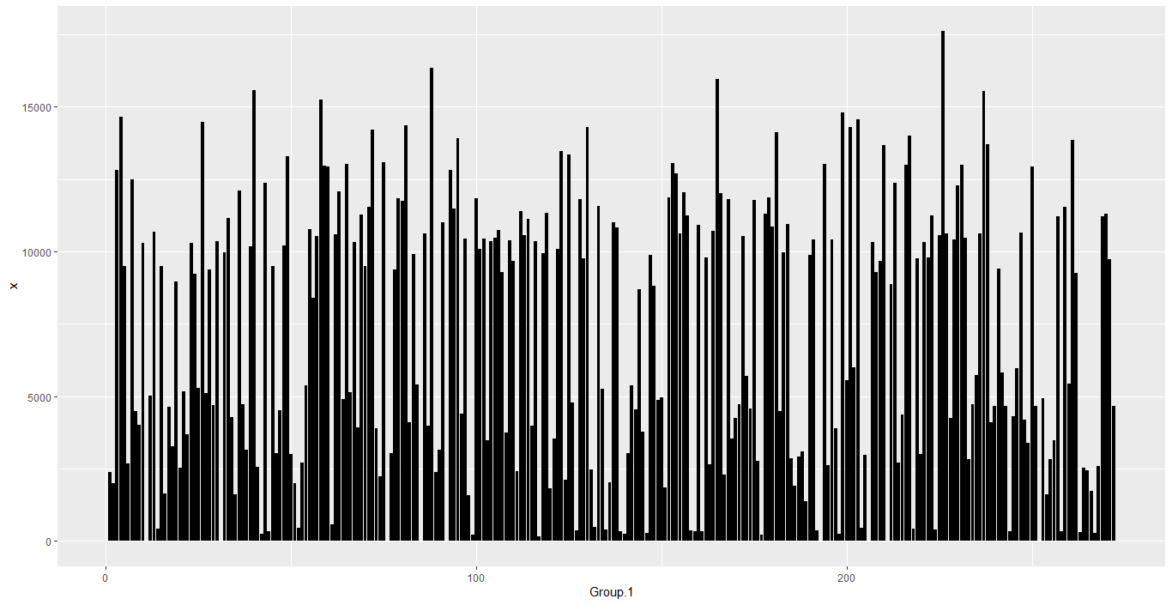
Explanation of the control store vs other stores
One way analysis of variance is used to compare average sales of products belonging to different stores.
It is observed that total sales of products is not same for all store numbers.
It is observed that quantities ordered by all stores is approximately same.
Also, it is observed that store number 226 has ordered maximum product quantity and it is also showing maximum sales.

Slide 10
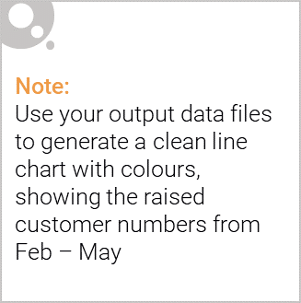
Call out of the performance in the trial store, determining if it was successful
Performance of store number 77 is having minimum product sales of 3040 with minimum product quantity 872.
Performance of store number 86 is having product sales of 10635.35 with product quantity of 3066.
Performance of store number 88 is having product sales of 16333.25 with product quantity of 3718.

